Slide 1
Cataloging Meeting
October 18, 2017
Santa maria public library

Slide 2
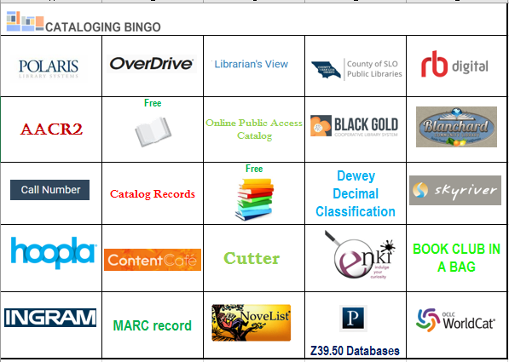
Introduction
**Welcome to the Black Gold Cataloging meeting and training
Introductions
Housekeeping
Cataloging Bingo!

Slide 3
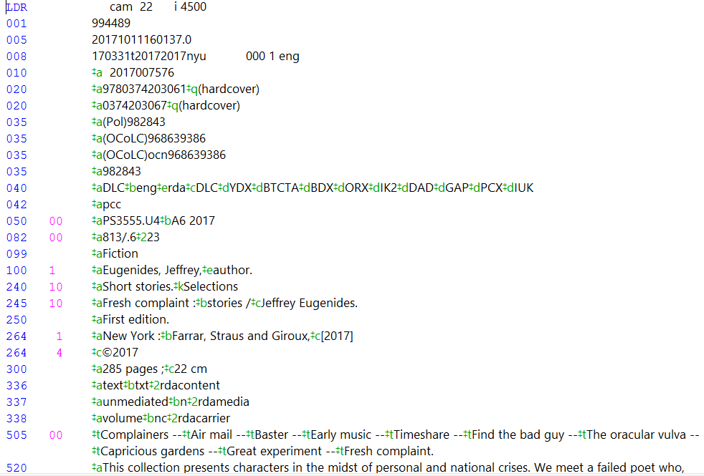
Anatomy of a Bib Record
MARC - Machine Readable Cataloging Records Marc21 Editor - Polaris

Slide 4
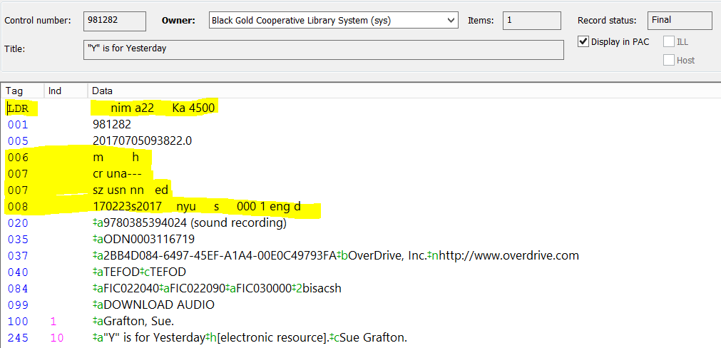
Fixed Fields
LDR - Leader
006 - Fixed Length Data Elements
007 - Fixed Physical Description
008 - Fixed Length Data Elements
Every bibliographic record has fixed fields and variable fields.
Fixed fields have the information coded in a predetermined position and order, with fixed length of fields and codes.
Fixed fields affect the format and how the records are displayed.

Slide 5
View a list of fields, codes and types of materials on the ATS site.
ATS
Cataloging
Tutorials & Resources Tips & Tricks

Slide 6
LDR/Leader First 24 character positions of the record
LDR cam 22 i 4500
Double click the 008 tag to open the LEADER dialog box to read the fields and codes.
Each box in the LEADER can be changed to a different code. Only change the Type of record or Bibliographic level if necessary.

Slide 7
Type of record a – Language material Bibliographic level m – Monograph Coding - MARC-8 Encoding level - Full level Descriptive cataloging (RDA) i – ISBD These codes = This display
Display in PAC view

Slide 8
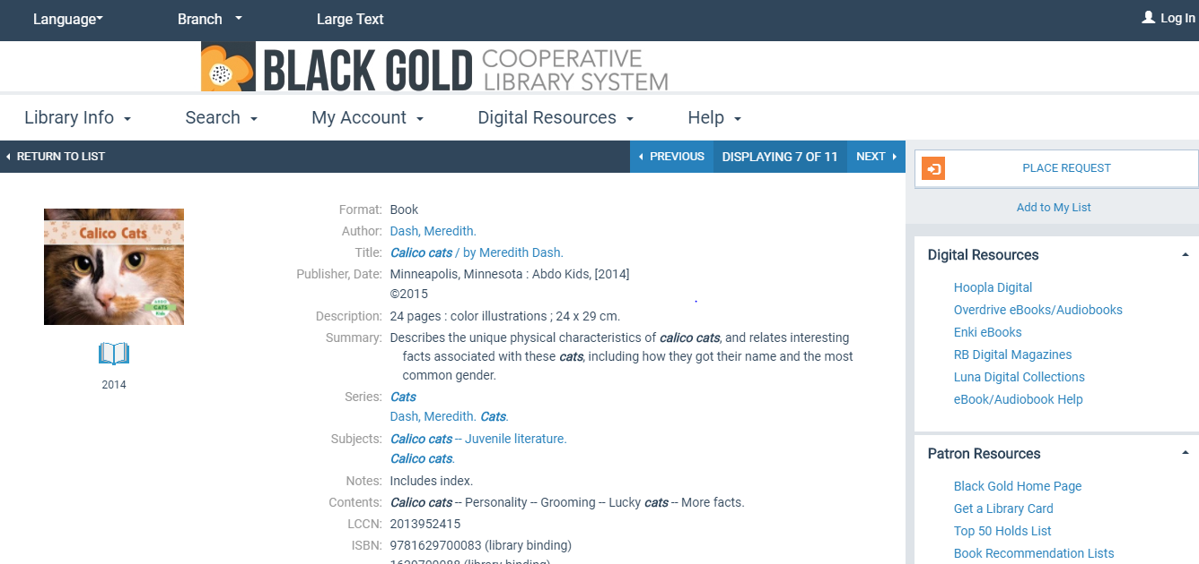
View of same record in the New OPAC

Slide 9
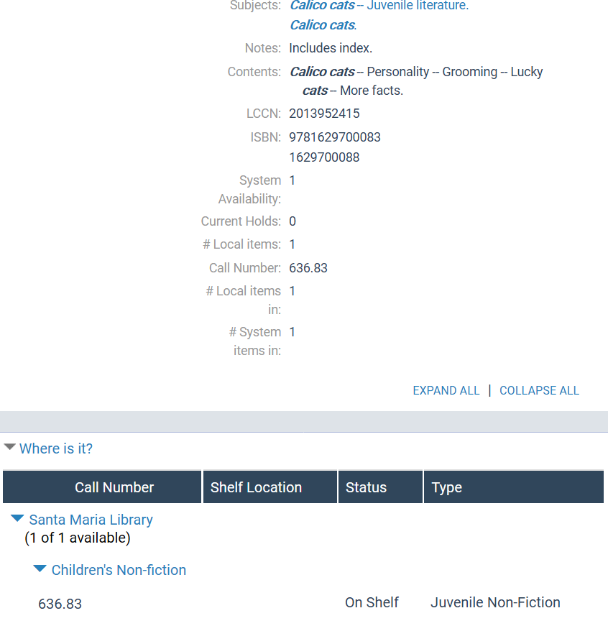
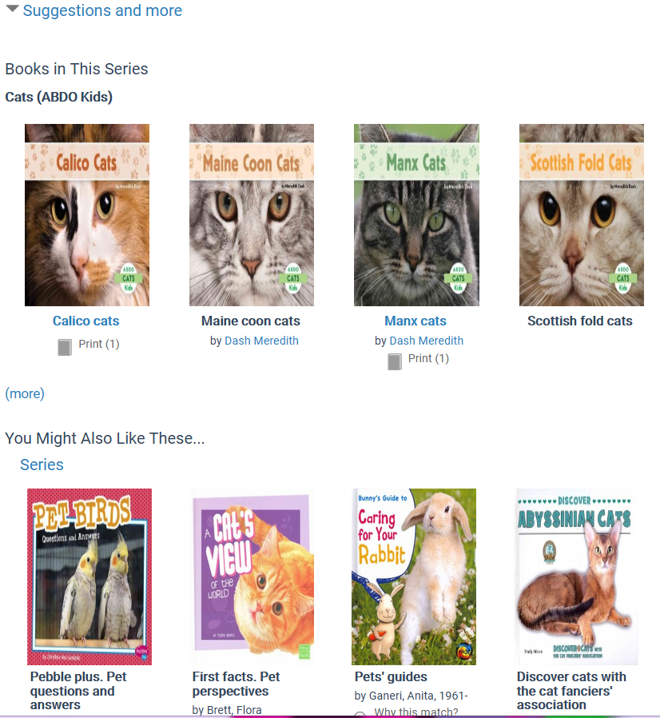
Records in the OPAC include Call#, Items, Suggestions, Reviews and more…

Slide 10
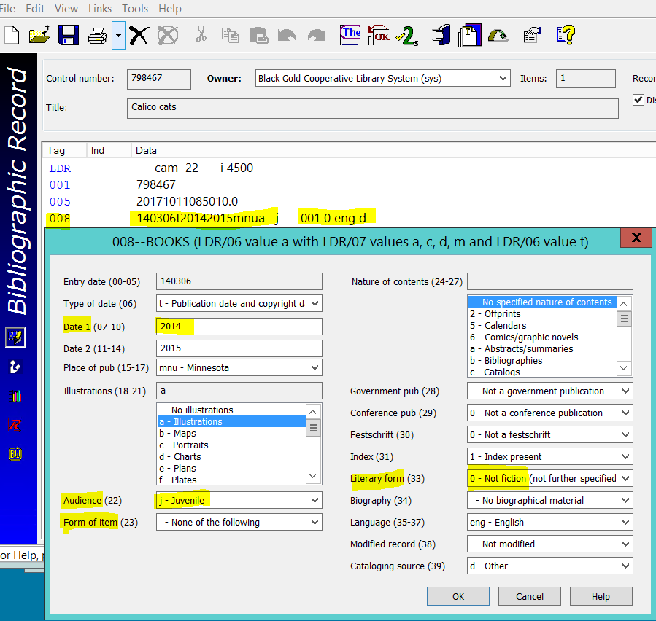
Every Bib Record has an 008 Fixed-Length Data Elements Field
008 140306t20142015mnua j 001 0 eng d
Date
Place of publication
Illustrations
Audience
Form of item
Nature of contents
Index
Literary form
Biography
Language

Slide 11
The 008 is very Important!
The 008 field contains several codes that Polaris pulls from to use in the Display and Search functions, such as Date, Place of pub, Illustrations, Audience, Form of item, Nature of contents, Index, Literary form, Biography, and Language.
Example the date under the icon in the PAC view is pulled from the Date 1 field in the 008:

Slide 12
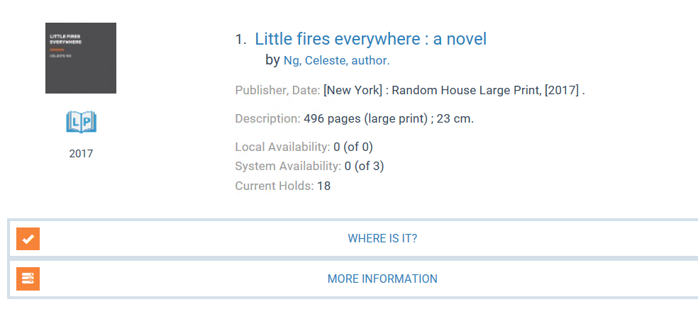
For a Large Print book to display correctly, the LDR/Leader and 008 must have the following codes:
a – Language material / Bibliographic level m - Monograph 008 Form of item d – Large print

Slide 13
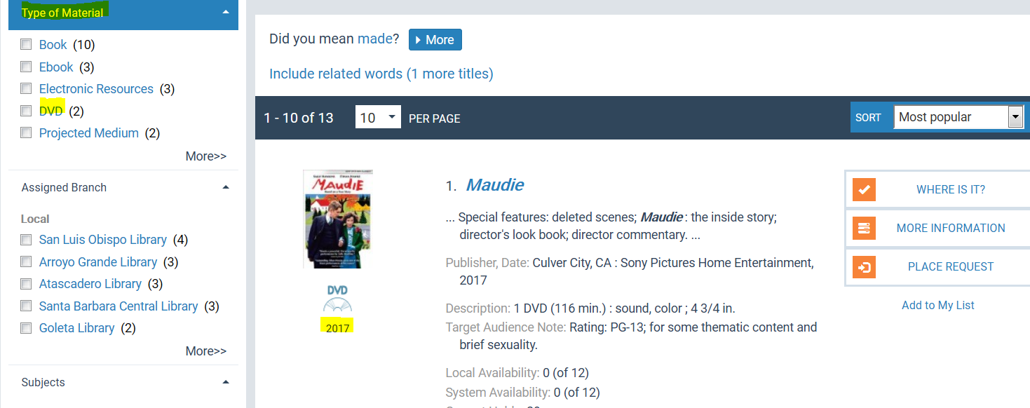
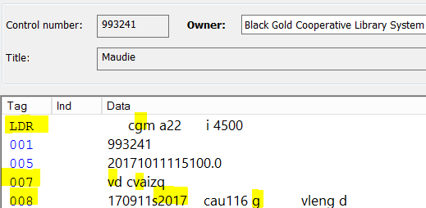
DVD Bib Record must be coded:
Leader Type of record g – Projected medium
007 Videorecording format v – DVD
008 Type of visual mat’l v – Videorecording
008 Date 1 2017, Audience g - General

Slide 14
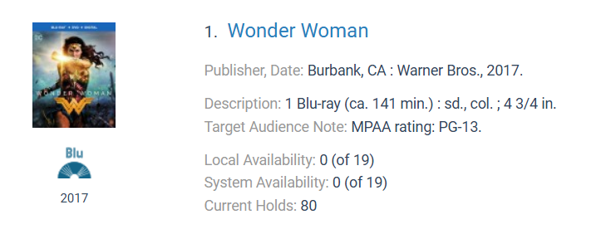
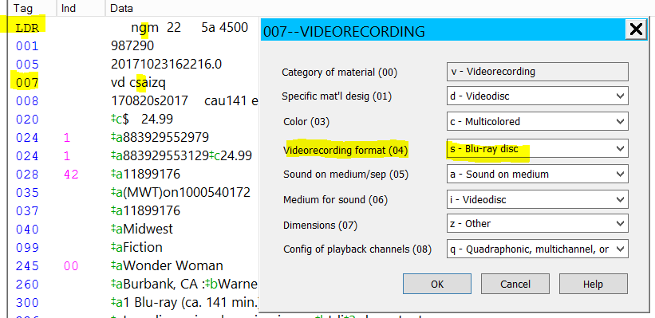
Blu-ray Bib Record must be coded:
Leader Type of record g – Projected medium
007 Videorecording format s – Blu-ray disc
008 Type of visual mat’l v – Videorecording
008 Date 1 2017, Audience g - General
for the record to display correctly
in the OPAC and in the Search.

Slide 15
Audio Book on CD
Leader Type of record – i – Nonmusical sound recording
007 Category of material s – Sound recording / Specific mat’l desig d – Sound disc, Speed f – 1.4 m. per sec.
Music CD
Leader Type of record j – Musical sound recording
007 Category of material s – Sound recording / Specific mat’l design d – Sound disc / Speed f – 1.4 m. per sec
Video Game
Leader Type of record m – Computer file
007 Category of material c – Electronic resources / Specific mat’l design o – Optical disc
008 Type of computer file g - Game
The codes and categories in the Fixed Fields may seem unimportant but they are actually crucial for helping patrons find the materials!
There is more information about Fixed Fields on the ATS website in the

Slide 16
Main Variable Fields
Variable fields vary in length based on the data. They are the fields 010 999.
Check the highlighted fields in every bibliographic record to make sure the data is correct.

Slide 17
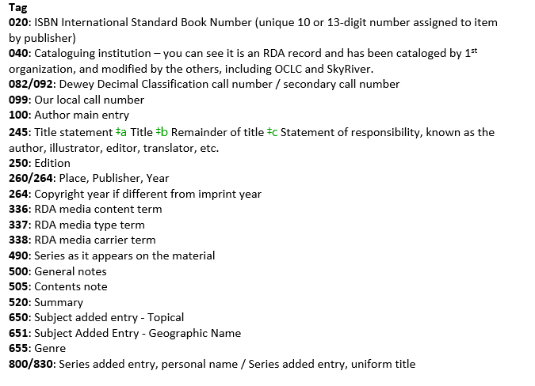
Every field begins with a tag indicating the field info. Common tags to check, edit or add in each bib record

Slide 18
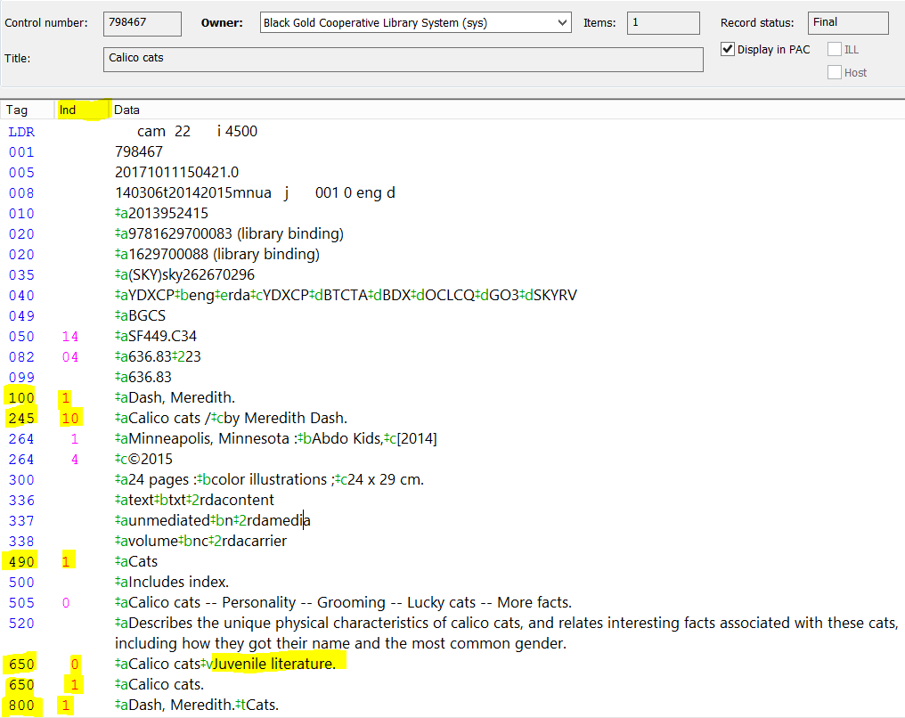
Indicators
Each indicator tells something about that field, and tells the computer how to display the field.
100: Author main entry, 1st indicator 0 = Forename, 1 = Surname, 2 = Family name
The most important indicators to check are in the 245 field. If they are not correct the material can’t be searched by Title!
245: Title statement, 1st indicator 0 = No added entry, 1 = Added entry, if there’s a 240 or 1XX 2nd indicator 0 = No nonfiling characters, 2 = a, 3 = an, il, lo, el, la, 4 = the
490: Series as on item, 1 = Series traced
650: Subject, added entry, 2nd indicator 0 = LC, 1 = LC for children, 2 = Medical, 7 = Source in subfield ‡2 800: Series added entry, personal name, 1st indicator 1 = Surname

Slide 19
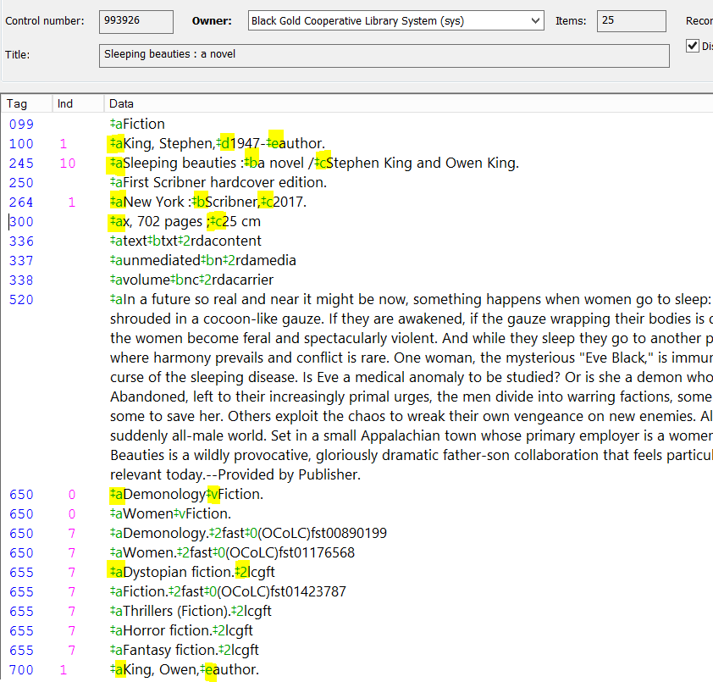
Subfield Codes in the Bib Record
Every field generally begins with Subfield Code ‡a which indicates what information it contains and is different for each field.
100: Author main entry- ‡a Personal name ‡d Dates associated with name ‡c Titles and words associated with name ‡e Relator term
245: Title statement- ‡a Title ‡b Remainder of title
‡c Statement of responsibility =‡b Title in another language 260/264: Publication- ‡a Place ‡b Publisher ‡c Year
300: Physical description- ‡a Extent ‡b Other physical details ‡c Dimensions
650: Subject added entry- ‡v Form ‡x General
‡y Chronological ‡z Geographic
655: Genre- ‡a Genre ‡2 - Source of term
700: Personal name added entry- ‡a = Personal name
‡e Relator term

Slide 20
Cataloging Resources
Go to the ATS website for
up-to-date Cataloging Resources
ats.blackgold.org

Slide 21
Cataloging Documents on the ATS Website
Authorized Names in Bib Records
Fixed Field Code cheat sheet
List of Genres to copy and paste into bibs
How to create and use Macros for efficient cataloging

Slide 22
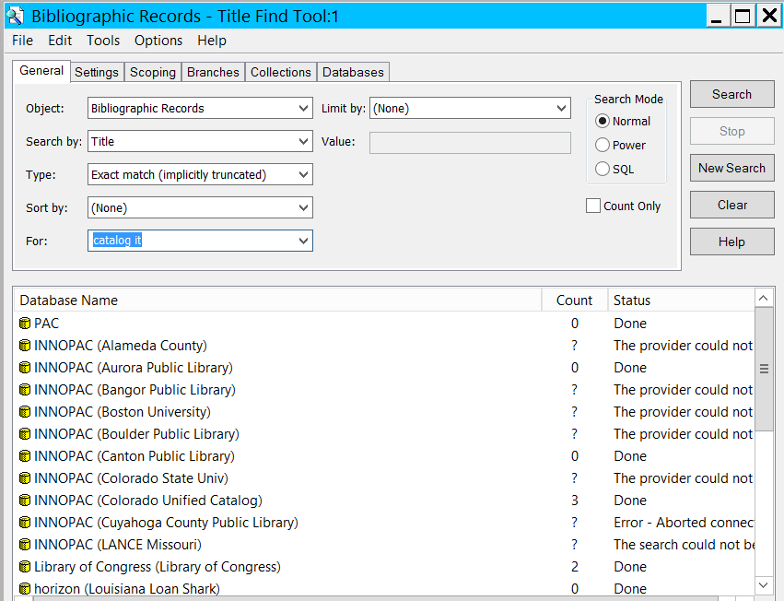
Z39.50 Databases Search in Polaris
View the video Tutorial on ATS Cataloging – Tutorials & Resources – Cataloging Resources & Tutorials
How to Find Records in the Z39.50 Database (Video)

Slide 23
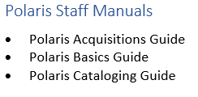
Polaris Resources on the ATS website
Polaris Manual and Training Videos
On ATS under Resources > Polaris

Slide 24
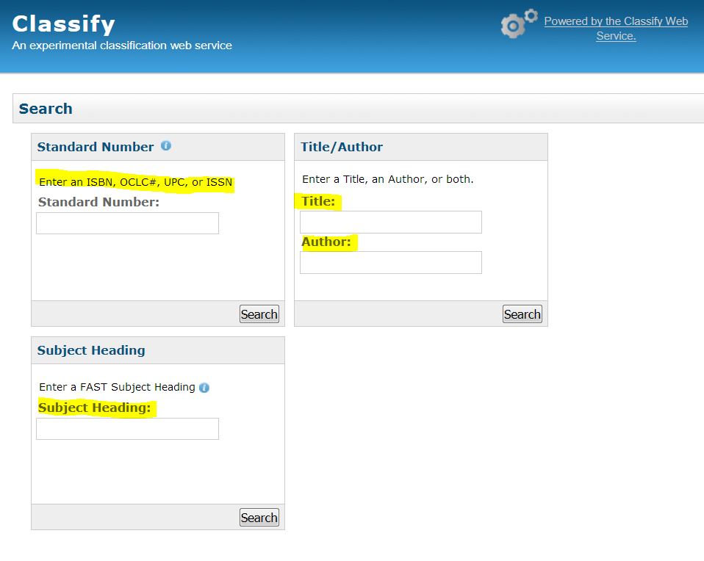
Free Online Cataloging Resources
OCLC Classify
Search for Call
Numbers by ISBN,
UPC, Title,
Author, or Subject

Slide 25
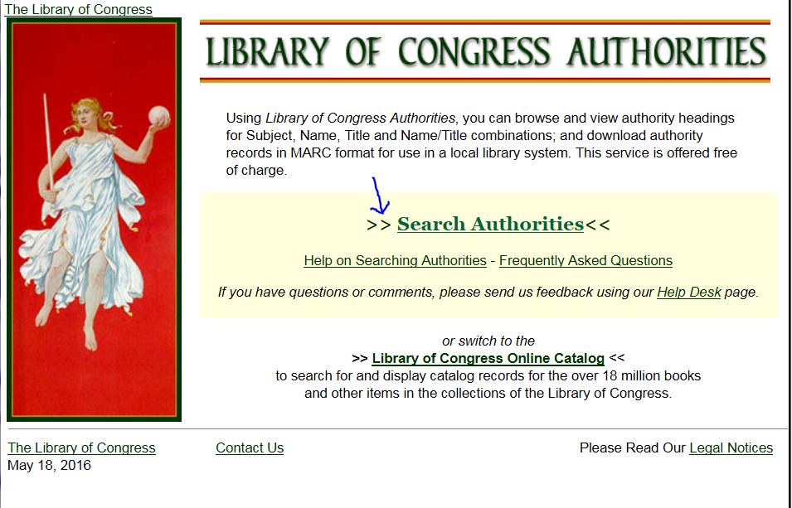
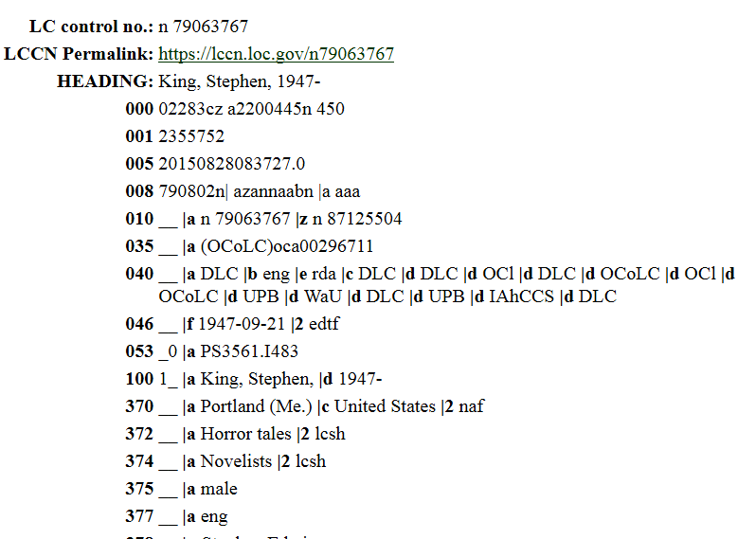
Library of Congress Authorities
Find Name, Subject, or Series Authority Records
Name Authority Record

Slide 26
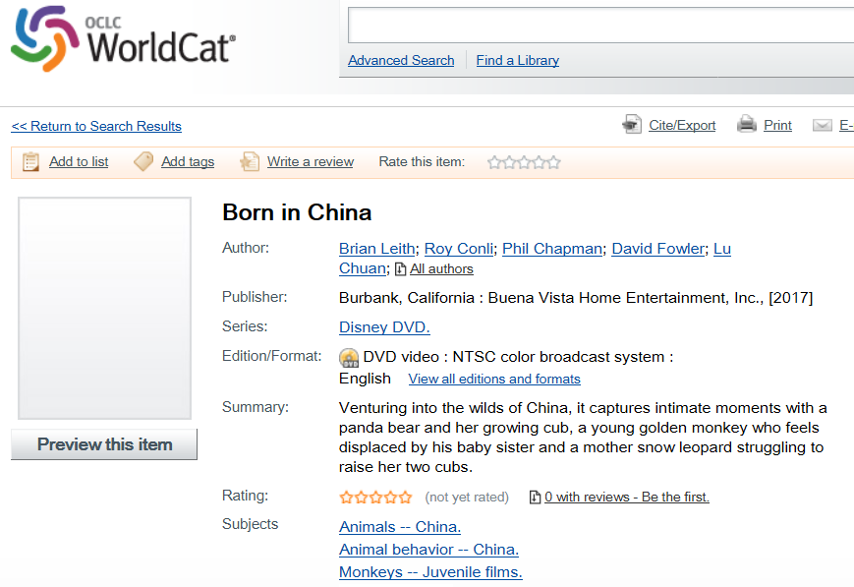
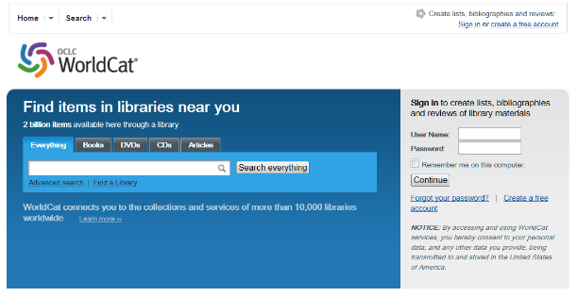
Search for records in WorldCat as reference
Use to find call#

Slide 27
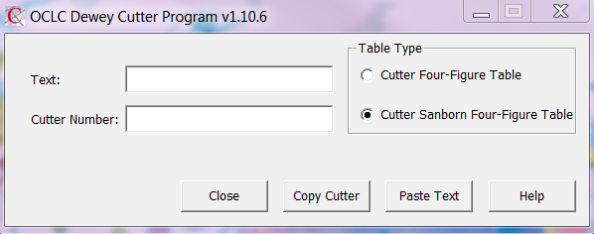
Dewey Cutter Program quickly retrieves the correct Cutter
- Download information on the Black Gold ATS Website -

Slide 28
SkyRiver Client details and the download are on the ATS Website
Cataloging Tutorials & Resources SkyRiver Cataloging

Slide 29
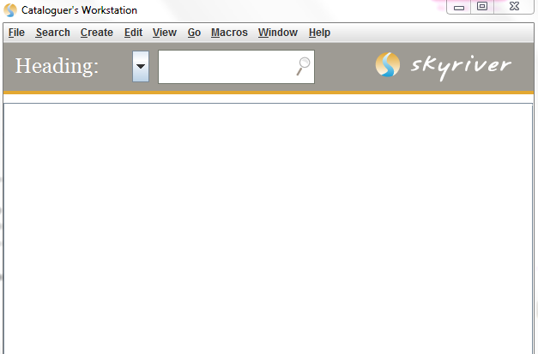
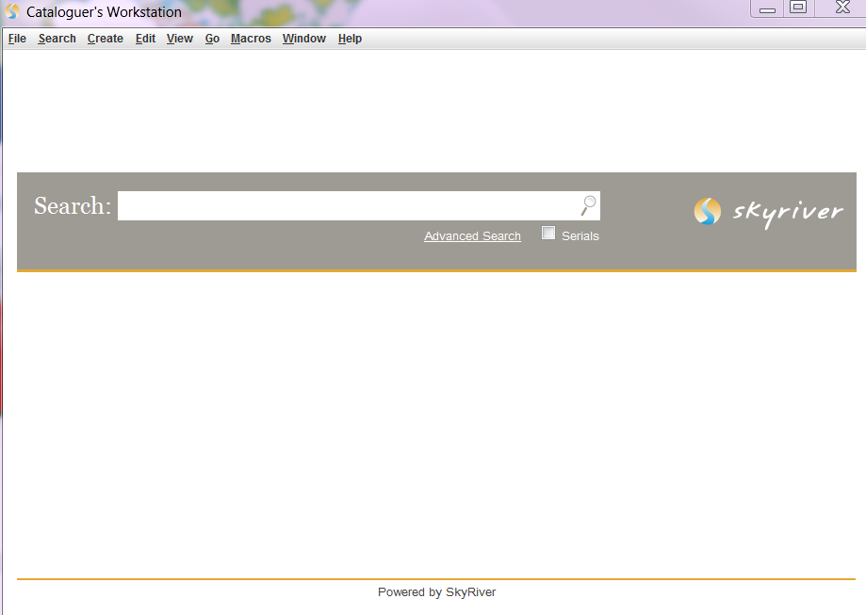
Download the SkyRiver Client to your desktop
SkyRiver Search Bibs –
Look up bib records in SkyRiver
SkyRiver Search Authorities –
Look up Name, Subject, Series Authority Records in SkyRiver

Slide 30
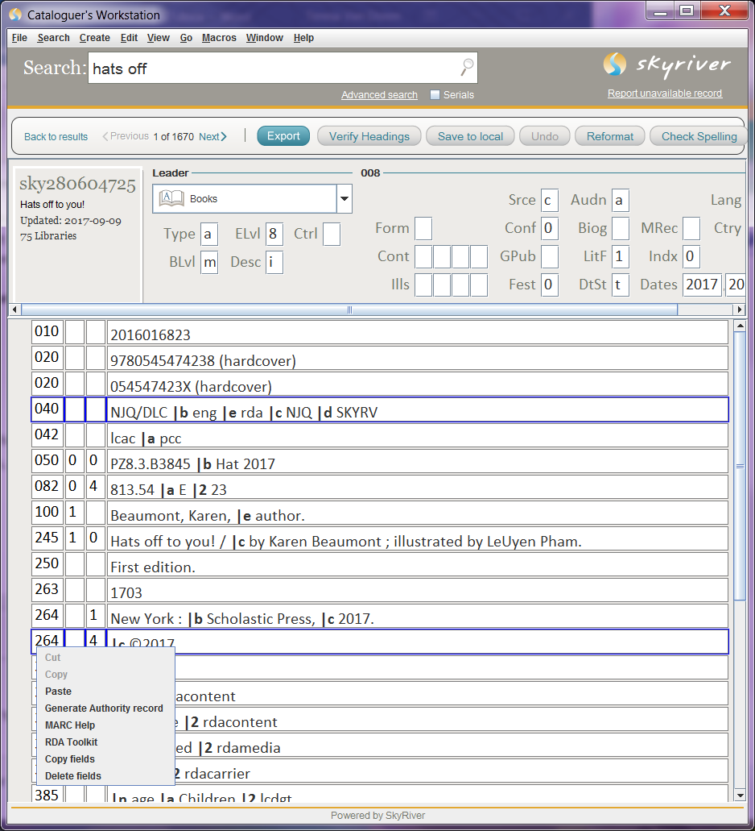
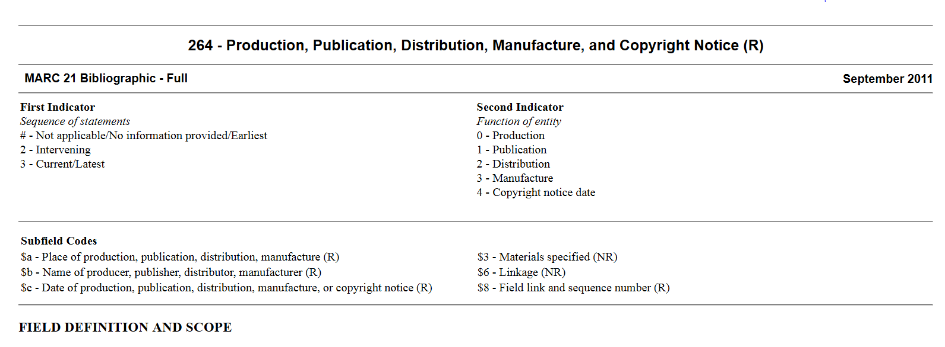
MARC Help
To find information about the Tags and Fields in Bib Records in SkyRiver, right click on the tag and click MARC Help.
A window opens with information about the Field, Indicators, Subfield Codes, Guidelines, Input Conventions, and some examples.

Slide 31
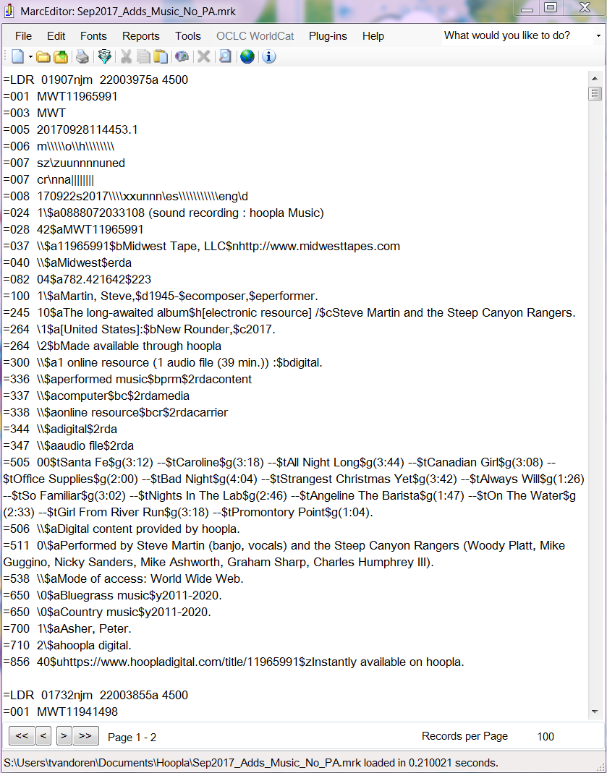
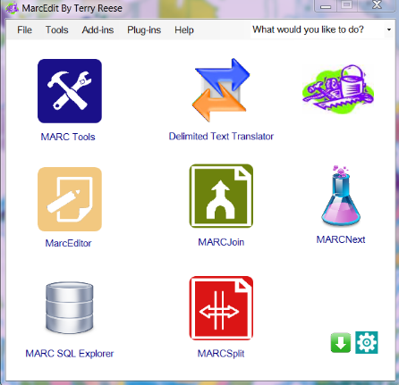
MarcEdit
Free online metadata editor
Edit files of MARC records
Link for the MarcEdit download is on the BG ATS website
Contact Teresa for details about using MarcEdit.

Slide 32
Basic Cataloging
Black Gold Catalogs New/Current Materials – 2018, 2017, 2016, 2015
in the Following Formats:
Please forward orders to Teresa
Email Cart
Email Order confirmation
Add 908 note
Put in record set
Email titles/ISBNs

Slide 33
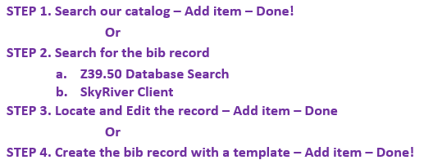
Jurisdiction Catalogers Catalog Older Materials/Other Formats –
2014 – older
Fiction books, Audio Books on CD, Music CDs, Video Games, Book + CD, Book/CD Kits
Basic Cataloging Steps

Slide 34
STEP 1. Search our catalog
Our catalog contains thousands of bib records- always check for an existing record before adding a new record.
In Polaris, click Cataloging and the Bibliographic Records - Title Find Tool.
Search by Title, ISBN, Author, UPC etc.
Match points to check: Author, title, ISBN, pub date, publisher, and edition.
If you find an existing record add your item record and you are done!

Slide 35
STEP 2. Search for the record
Search the Z39.50 Databases
Bibliographic Records - Title Find Tool, click the Databases tab, click Select All or check the databases you want, such as PAC (our catalog), SkyRiver and Library of Congress.
Click the General tab and Search by Title or ISBN, click Search. (Search by UPC code under ISBN for DVDs/Blu-rays in Z39.50.)
Tip: If the Status says Searching… click Stop and click Search again to return results. Status Done indicates the number of records found.
Double click on Database such as skyriver (Sky River) (or other database) to see a list of the found records. You may have to repeat this several times to find a record.
Look for a matching record by title, author, format, and pub date. Double click to open and edit record.

Slide 36
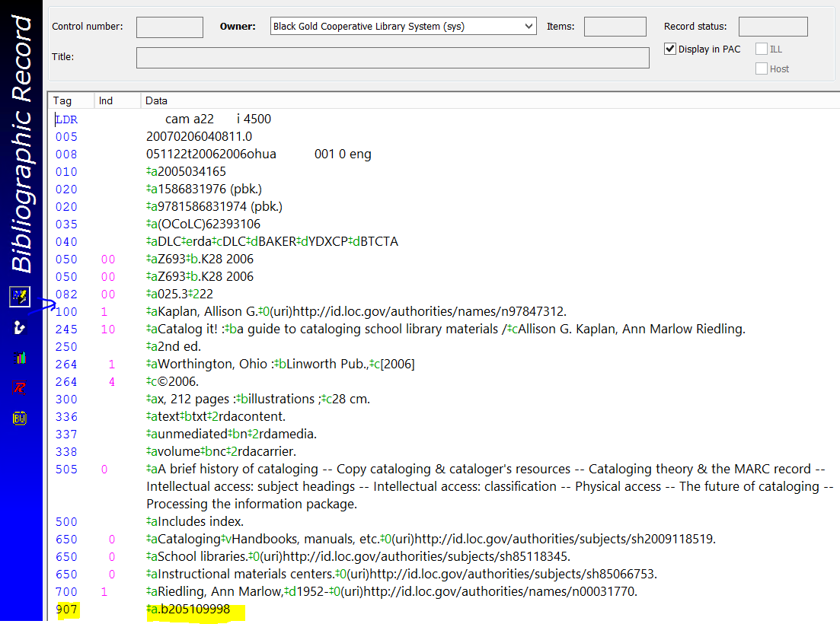
Next Step - Edit the Record
Scan the record for errors
Add the 099 – create a Macro – copy and paste the call# from the 082
Check the name and title
Check the 245 indicators
Check the date in the 264/008
Scan the summary or contents note
Remove the 907
Save the Record, Add your Item, and you are done!

Slide 37
CALL NUMBERS
Our Local Call Number Policies are:
Use the call# in the 082 if it is entered correctly. The call# is based on the first subject in the 600, 610 or 650 field.
Extend the call# to 5 digits after the decimal, unless it is a zero. For example, 082 call number for American sniper is 956.7044/342, but the 099 call# is 956.70443. The 082 call number for The red web is 303.48/330947, but the 099 call number is 303.4833.
Travel call numbers can cut off after the 04. For example, the 082 call# for Route 66 is 917.8/0434 but the 099 call# is 917.804.
Auto repair call#s for auto repair books can use 629.287.
Music CD bibs can use MUSIC CD and Video Game bibs can use VIDEO GAME. Create Macros to add call# and other fields easily and quickly.

Slide 38
Dewey 23
How to find a Call Number
If you have a record without a 082 or 092 you can try the following methods:
Check the list of preferred call#s on the ATS site- Cataloging > Standards Manual > Dewey 23 Call Numbers for Specific Subjects
Check by title or subject on the website Classify and use the Most Frequent or Edition: 23 call# in the 099 field. Shorten the call# to 5 digits past the decimal.
Locate material in WorldCat- follow links to library holdings.
Check our catalog or Z39.50 for the same title in another format.

Slide 39
CUTTER NUMBERS
A Dewey Cutter number is an alpha-numeric code based on the name in the 600 or 610 subject field of the bibliographic record.
The following works need a Cutter:
Biographies for individual people or one group
Biographies for 2 individual people who share the same last name and both their full names produce the same Cutter;
Family histories; e.g., “Smith family” or “Windsor, House of”
Musical groups, sports teams or other groups with distinctive names; e.g., “Beatles” “Hell’s Angels” or “St. Louis Cardinals”
Shakespeare criticism is Cuttered for the author/editor
Works of criticism (authors, artists, photographers, etc.), Cuttered for the subject in the 600/610 field
Do not Cutter:
Biographies about 2 or more people whose last names produce different Cutters
Biographies of animals
Books of poetry
Works with the 600 subject of Jesus (232) or Shakespeare (822.33) – the call numbers are the correct number for the subjects

Slide 40
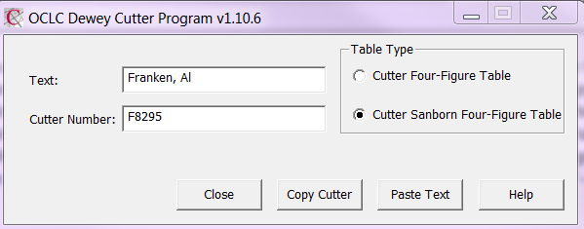
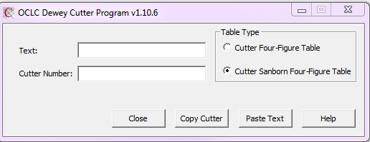
Copy and paste the name from the 600 or 610 subject field of the bib record into the Text field to retrieve the Cutter Number. Click Copy Cutter:
Download the Online OCLC Dewey Cutter Program to access the Cutter-Sanborn Four-Figure Table
Paste into the bib record after the call# in the 099 field.

Slide 41
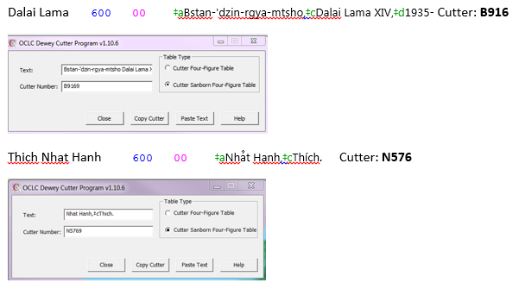
Input name exactly as it appears in the 600/610 field

Slide 42
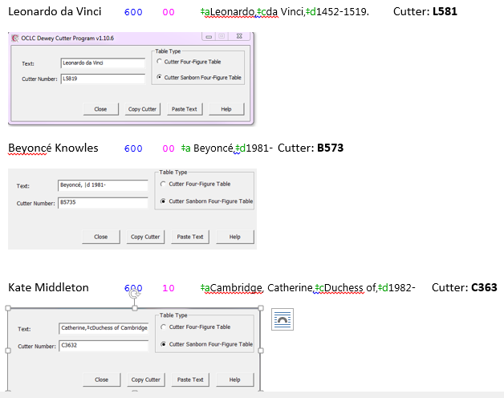

Slide 43
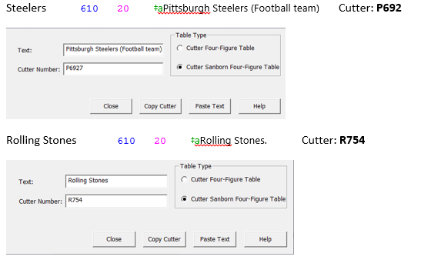

Slide 44
Editing Minimal Record
ISBN/020- ISBN (pbk) ‡q(pbk.) ‡qhardcover
082/092- Leave as is, unless the 092 is a word
Call#/099- Copy and paste from the 082
Date- Check date in the 260/264 field to the date in the 008
Name- Check the name in the 100 Main entry name in authorities if the record is not a full or DLC/NLC record.
Title Field- Ist indicator 1 if there is an author or uniform title, and a 2nd indicator 2 for a, 3 for an, el, la, il, and 4 for the Check the Title statement punctuation/subfields are correct- $aTitle proper :$bsubtitle /$cstatement of responsibility; also =$bTitle in another language.
Added Title- Add a 246 with any added titles, spelling out abbreviations in the first 5 words.

Slide 45
Editing Minimal Record, cont.
RDA Fields- Leave RDA fields 336, 337, and 338. 340 etc.
Series- Trace 490 field
Summary- Add the summary if enough time
599 Local Note- No longer necessary to add the 599 with your jurisdiction code and initials.
Subjects- Bib records should have at least one 650 subject. It’s ok to leave/ignore 650/655 fields ending in Bisach, fst, bidex, etc. and genres ending in gsafd or lcgft. Use macros or copy and paste.
lcgft = Library of Congress Genre/Form Terms
gsafd = Guidelines on Subject Access to Individual Works of Fiction, Drama, Etc.

Slide 46
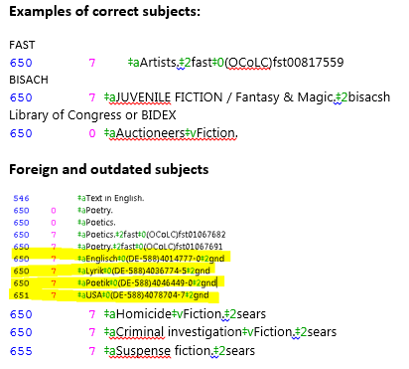
Editing Minimal Record, cont.
Other fields- 035, 049, 050, 090, 949, 970, relate to other data and must be left in the record exactly as they appear. To check the fields use MARC Help in SkyRiver.
Save the record to add it to the Polaris catalog.
Add your item record(s).
View record in the PAC view to make sure the record is displaying correctly.

Slide 47
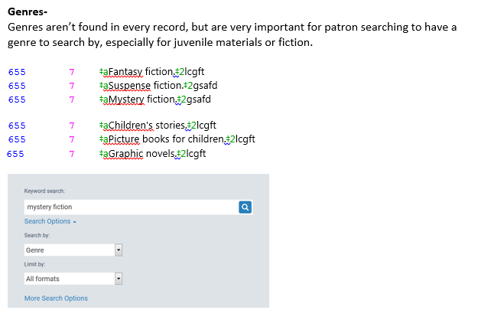
Genres

Slide 48
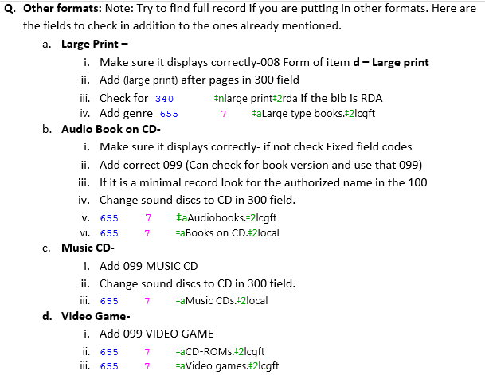
Other
Formats

Slide 49
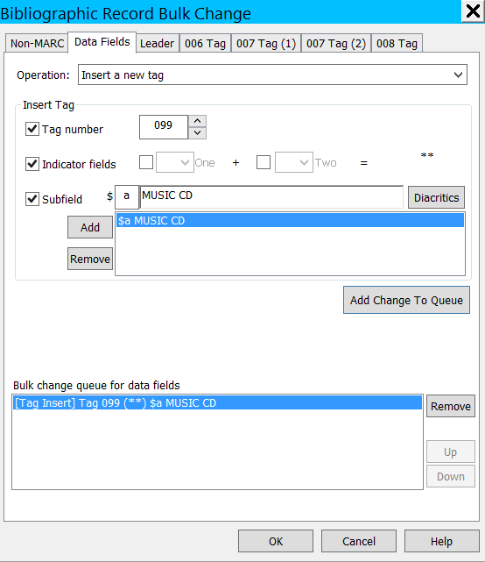
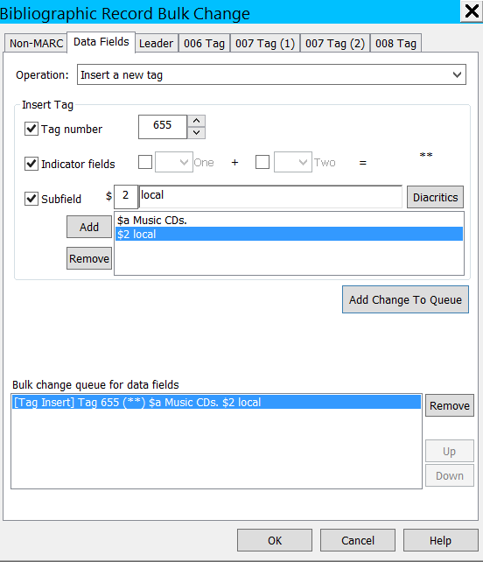
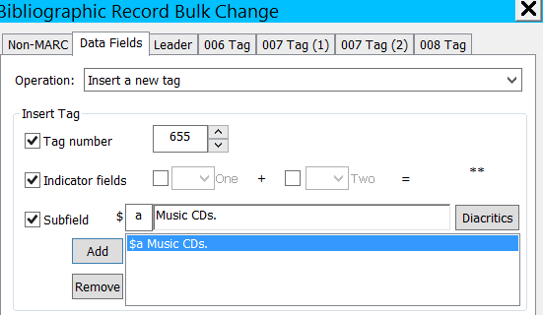
Downloading/Importing Records
Bulk Change Tool

Slide 50
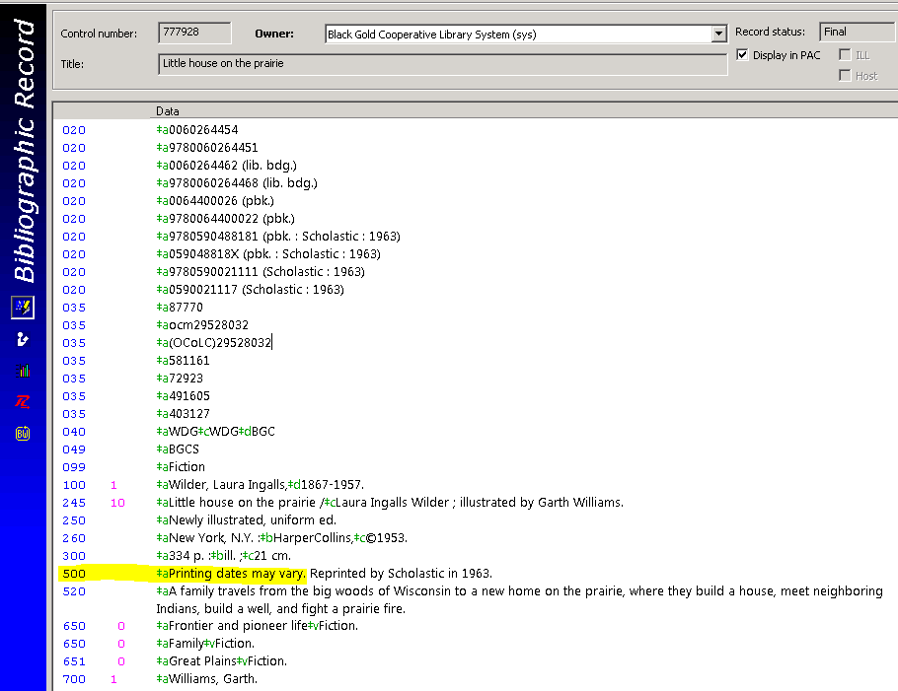
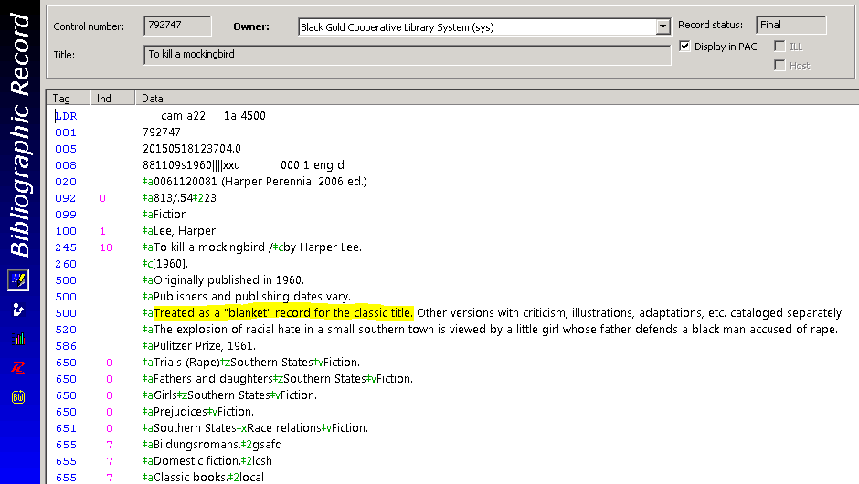
Cataloging Exceptions
Fiction Records
Blanket Classic Records

Slide 51
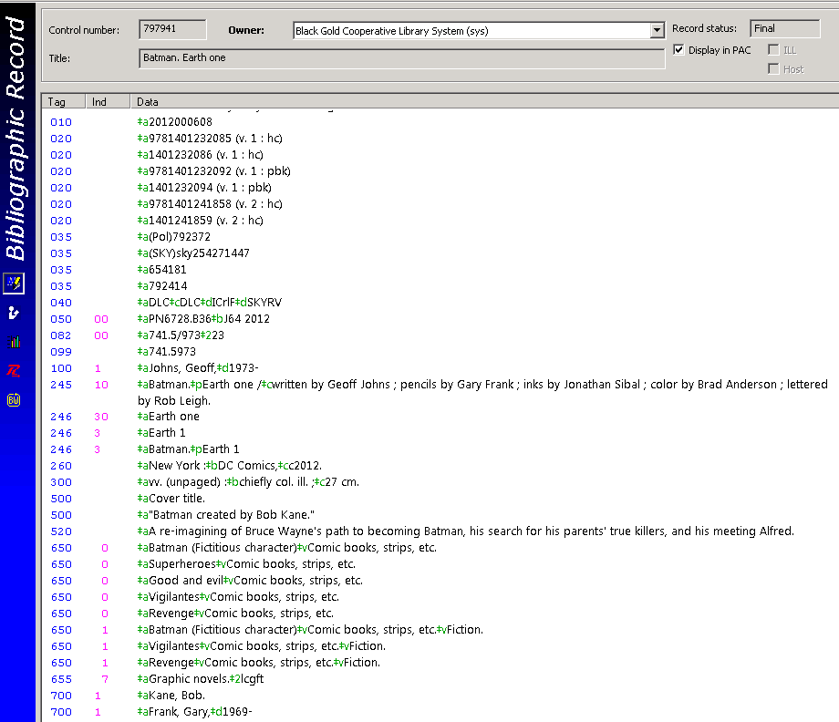
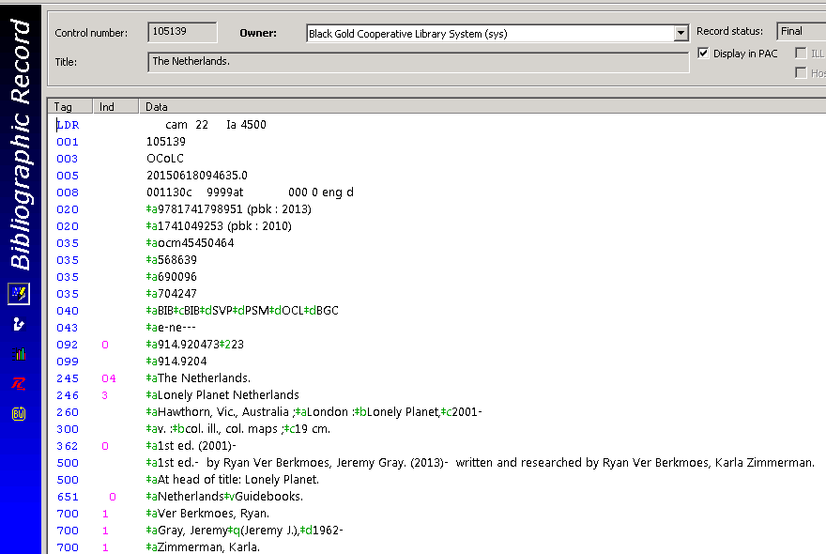
Set Records
Serial/Open-entry Records

Slide 52
CATALOGING DVDS
Look for a full record in SkyRiver or Z39.50. A full record will have authorized names, the title entered correctly, and 511, 521, 538, 546 fields, among others.
Do not change an AACR2 record to an RDA record. Simply accept the record in the format it has been cataloged in.
Add the 099 call# to the record:
Fiction- 099 ‡aFiction Use 099 Fiction Macro
Nonfiction- 099 ‡a956.70443
Use the call# in the 082/092 field, and cut off 5 digits after the decimal.
Change ‘videodisc’ in the 300 field to ‘DVD’ or ‘DVDs’ for multiple discs:
300 ‡a1 DVD (96 min.) :‡bsound, color ;‡c4 3/4 in.

Slide 53
If the record is RDA, leave the 336-380 and 7XX RDA fields as they appear, but remove the partial 100 field of one of the actors:
336 ‡atwo-dimensional moving image‡2rdacontent.
337 ‡avideo‡2rdamedia.
338 ‡avideodisc‡2rdacarrier.
340 ‡b4 3/4 in.‡2rda.
344 ‡adigital‡boptical‡gsurround‡hDolby digital 5.1‡2rda.
345 ‡awidescreen (1.78:1)‡b24 fps‡2rda.
346 ‡bNTSC‡2rda.
347 ‡avideo file‡bDVD video‡eregion 1‡2rda.
380 ‡aMotion picture.
730 ‡iContainer of (work):‡aZootopia (Motion picture)
100 ‡aBraga, Sonia

Slide 54
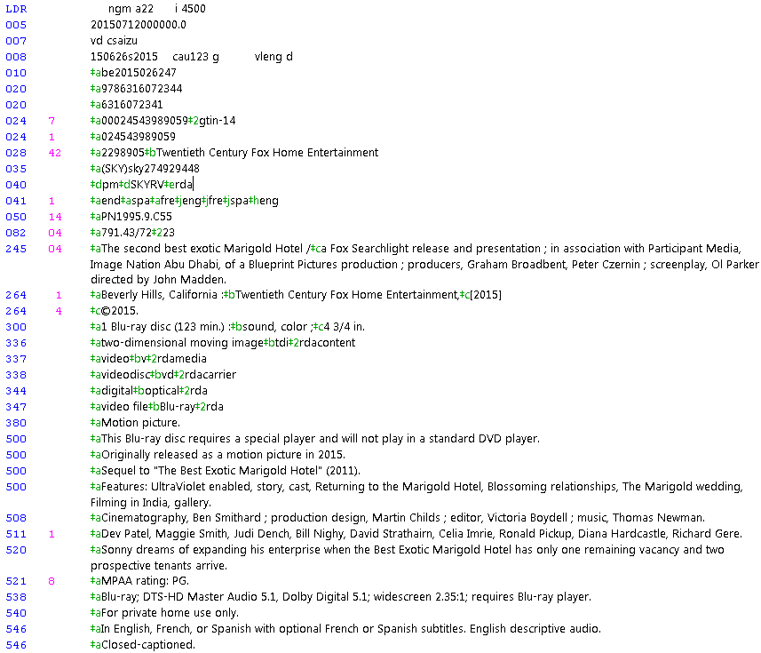
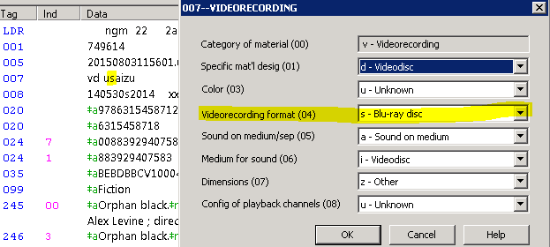
Cataloging
Blu-rays

Slide 55
Authorizing Names
Authorized Names
The Names, genres, subject and series fields are linked to the matching authorities records in Polaris. When the name is entered in the standardized format, all the materials will be accessible under the single, authorized name.

Slide 56
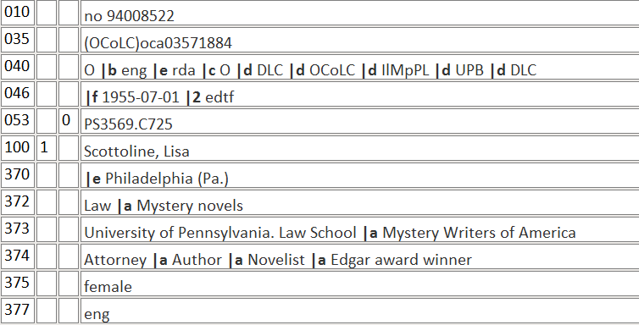
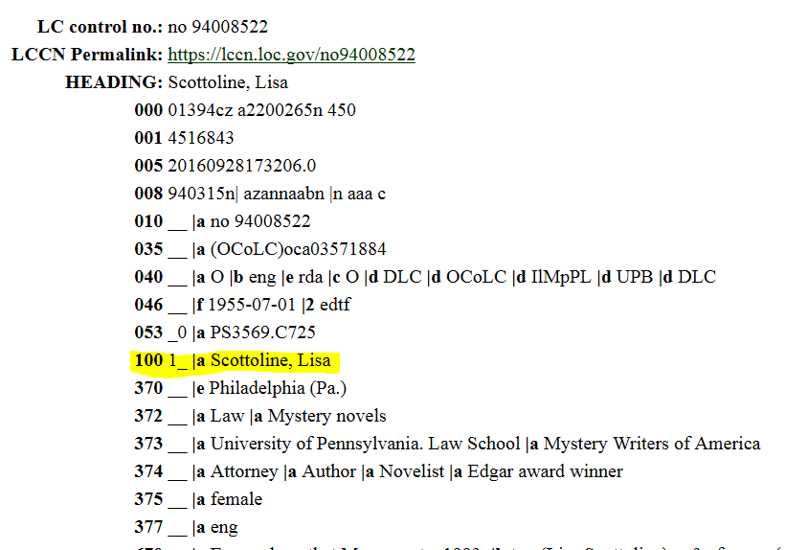
SkyRiver Search > Authorities
Library of Congress Search > Authorities

Slide 58
Authorizing Series
Search the SkyRiver Authorities or LOC Authorities for the authorized format of the 800 or 830 field.

Slide 59
Copy and paste into the Bib record, as an 800 for series by Author name, and then fix the delimiter symbols.
McCall Smith, Alexander, |d 1948- |t Isabel Dalhousie novel
800 1 ‡aMcCall Smith, Alexander,‡d1948-‡tIsabel Dalhousie series ;‡v1.

Slide 60
800 Series Added Entry - Personal Name
Novelist
Amazon

Slide 61
830 Series Added Entry - Uniform Title
490 1 ‡aDK readers. 3, Reading alone
830 0 ‡aDorling Kindersley readers.‡n3,‡pReading alone.
Type in the 490 in the Authorities Search:
DK readers. 3, Reading alone
Copy and paste results in the 830, and fix delimiters with Control Q:
Dorling Kindersley readers. |n 3, |p Reading alone

Slide 62
RDA vs. AACR2
AACR2 - Anglo-American Cataloguing Rules, Second Edition

Slide 63
RDA - Resource Description and Access
RDA’s mantra - “take what you see.”
No Latin abbreviations
Names are in a fuller form
Replace GMD by content/carrier/media

Slide 64
RDA Fields in Various Formats

Slide 65
E-Resources
Access E-Resource
titles in vendor modules
on the PAC

Slide 66
or via the link in the
Bib record in our catalog

Slide 67
Bib record in Polaris
Record in OverDrive module

Slide 68
Not currently available via OverDrive

Slide 69
Bib Record Templates in Polaris
Polaris Help

Slide 70
Proceed With Caution!
#1 Important note: Copy and paste whenever possible. If you know you have the correct author in another bib you can copy the entire field
100 1 ‡aGoodman, Elizabeth,‡d1980-
And paste it into your bib.
Check the name, subjects, series, genres in Authorities, and copy and paste them in from Authorities, Worldcat, or another bib record to save time and reduce errors.
#2 Important note: The new bib created from the template is missing the Date 1, the Audience, Place of Publication, etc., in the 008, and the call#, etc. Edit 008 and add the date and Place of pub and Audience and any other info you have (Index, Comics/graphic novels, Biographical material), and make sure the Literary form and Language are correct.

Slide 71
Polaris 5.5 Upgrade
New Layout and Design

Slide 72
New Icons

Slide 74
Baker & Taylor Shelf-Ready Records
Streamline shelf-ready MARC record loading procedures
Consolidate loading to M/W/F
Allow 24-48 hours for records to be loaded
Contact Baker & Taylor if shipment arrives before MARC record notification

Slide 75
Questions?
Conclusion
Next Meeting – Future Topics
Adjournment- Lunch

